Slide 1
EDNA
Emergency Disaster Network Application
21st Century Solutions to Hurricane Relief
and Disaster Management
Team Hurricane Helper

Slide 2
TOC
Overview
Call Demo
Volunteer Sign-Up
Problems to solve
Cloud Call Flow
Code Description
Features
Cost Analysis
Vision
Scenario
Website

Slide 3
During an Emergency Event...
1
Emergency numbers receive more calls than usual
3
City can’t realistically do anything with data collected
2
Average cost for non-commercial call center is $0.50/min
4
The average wait time to talk to a responder is longer
Notes:
During an emergency
Emergency numbers receive xxxx calls more than usual
The average cost to a city for more phone support is: $xxx
The average wait time for a responder to answer is xxx minutes
Theres nothing that the city can do with the data collected by these calls
Solutions
Our system spins up a new instance for a city instantly at near zero cost
Our system scales to receive any number of calls at a time
Our system can be used by the non tech savvy
Cities can collect data related to the usage of emergency calls
Our system routes calls to local dispatchers which increases revenue

Slide 4

Overview
EDNA is an online platform that streamlines disaster management by using a national volunteer network in a cloud call center.

Slide 5
Solutions solved by EDNA
Active S.O.S. and Storm Alert monitoring for registered users
Global Distributed Network of Volunteer Responders
Accessible to all regardless of socio-economic status or tech savvy
Non-emergency virtual assistance to all callers
Data collection related to use of disaster relief
New instance for a city installs instantly at zero cost
Notes:
Our system spins up a new instance for a city instantly at near zero cost
Our system scales to receive any number of calls at a time
Our system can be used by the non tech savvy
Cities can collect data related to the usage of emergency calls
Our system routes calls to local dispatchers which increases revenue

Slide 6

Meet Grandma Edna
-Registered for S.O.S. and Alert system
-Only has a landline phone
-During hurricane tree fell on backyard fence
-After hurricane, Edna dials 3 on speed dial

Slide 7
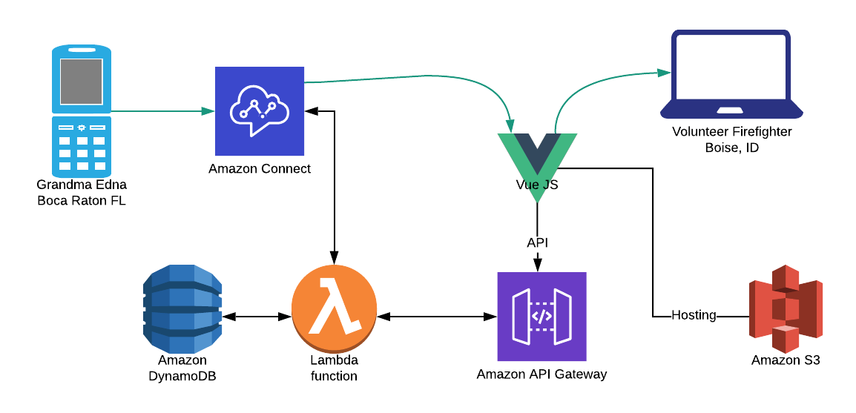
Call Demo

Slide 8
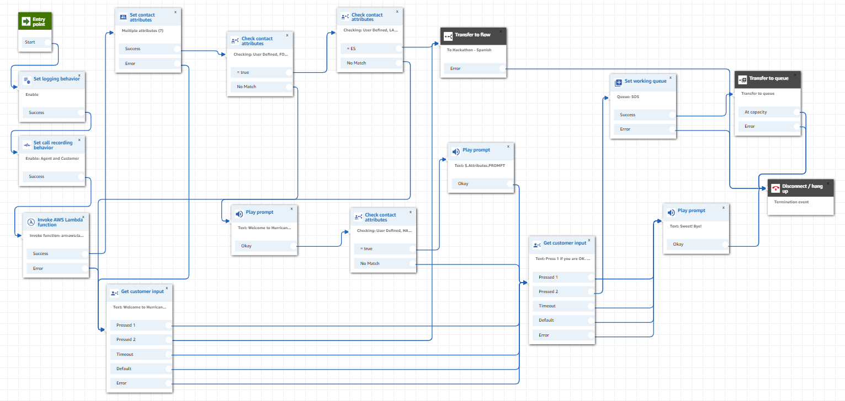
Cloud Call Flow Description

Slide 9




Cost Effectiveness
EDNA Call Cost:
$0.0022 per minute
150 volunteers
4 hours a day for 2 weeks
940 GB of recording
$1,121 TOTAL
Non-Commercial* Call Cost:
$0.50 per minute1
With same parameters
Without contractual agreements
$252,000 TOTAL
Notes:
1. https://mashable.com/2012/04/24/call-center-death-exaggerated/ Mashable
https://www.vhtcx.com/call-center-metrics/cost-per-minute/#targetText=It%20is%20commonly%20accepted%20that,providing%20service%20on%20other%20channels. VHT
https://www.sascallcenter.com/pricing/
Calculation for commercial cost 150 volunteers x 4 hrs x 14 days x 60 min =

Slide 10
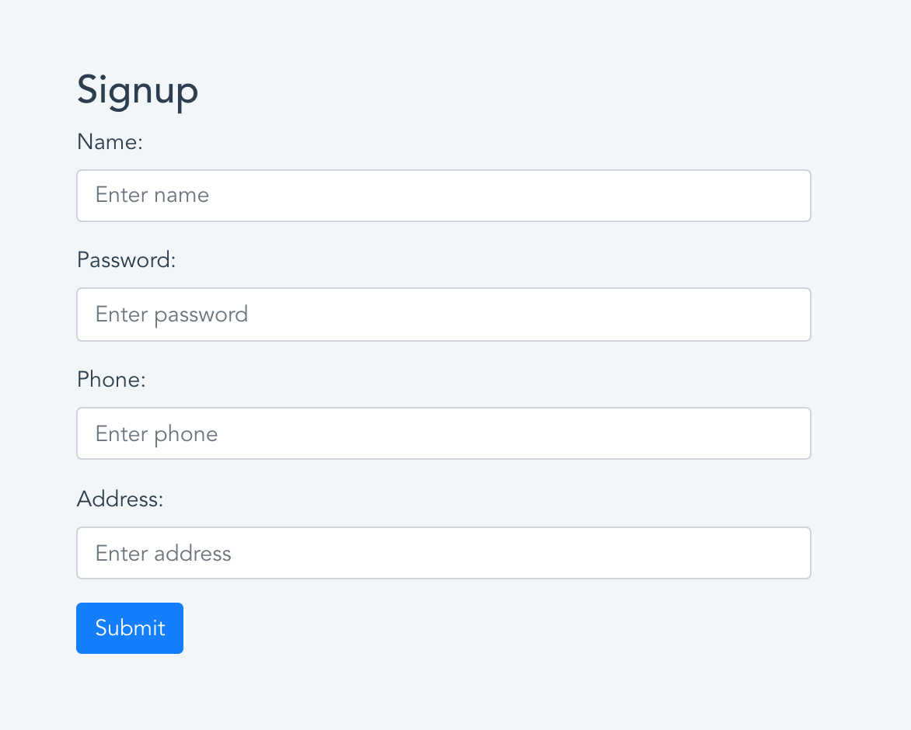
Volunteer and User Registration
EDNA Website
Data Collected includes Name, Phone #, Email, Address, Medical conditions
Volunteer Implications:
Volunteers can apply from anywhere across the globe to volunteer their time from the comfort of their home

Slide 11


Scalability
Local Scope of Hurricane Relief in South Florida
Product/Service can be taken globally
Fast, cheap, automated disaster management

Slide 12










Thank you.
Judge Q&A
https://d24ievhur353et.cloudfront.net/

